Slide 1
Project Management
CT050-3-3-PRMGT
04: Planning Projects
Part 1 - Integration & Scope

Slide 2
Topic & Structure of The Lesson
Knowledge area | Planning process | Outputs
Project integration management | Develop project management plan | Project management plan
Project scope management | Plan scope management Collect requirements Define scope Create WBS | Scope management plan Requirements management plan Requirements documentation Requirements traceability matrix Project scope statement Project documents updates Scope baseline Project documents updates

Slide 3
Learning Objectives
Describe the importance of creating plans to guide project execution
List several planning processes and outputs for project integration and scope management
Discuss the project integration management planning process and explain the purpose and contents of a project management plan

Slide 4
Learning Objectives (continued)
Describe the project scope management planning processes
Explain the purpose and contents of a scope management plan and requirements management plan
Discuss different ways to collect project requirements
Create a scope statement to define project scope
Develop a work breakdown structure (WBS) and a WBS dictionary to clearly describe all of the work required for a project
4

Slide 5
Key Terms You Must Be Able To Use
If you have mastered this topic, you should be able to use the following terms correctly in your assignments and exams:
xxxxx

Slide 6
Introduction
Many people have heard the following sayings:
If you fail to plan, you plan to fail.
If you don’t know where you’re going, any road will take you there.
What gets measured gets managed.
Successful project managers know how important it is to develop, refine, and follow plans to meet project goals
People are more likely to perform well if they know what they are supposed to do and when
6

Slide 7
Project Planning Should Guide Project Execution
Planning is often the most difficult and unappreciated process in project management
Often, people do not want to take the time to plan well, but theory and practice show that good planning is crucial to good execution
The main purpose of project planning is to guide project execution, so project plans must be realistic and useful
7

Slide 8
Figure 4-1. Planning Processes and Outputs for Project Integration and Scope Management
Knowledge area | Planning process | Outputs
Project integration management | Develop project management plan | Project management plan
Project scope management | Plan scope management Collect requirements Define scope Create WBS | Scope management plan Requirements management plan Requirements documentation Requirements traceability matrix Project scope statement Project documents updates Scope baseline Project documents updates
8

Slide 9
Project Integration Management
Project integration management involves coordinating all the project management knowledge areas throughout a project’s life span
The main planning output is a project management plan
9

Slide 10
Project Management Plans
A project management plan is a document used to integrate and coordinate all project planning documents and to help guide a project’s execution, monitoring and control, and closure
Plans created in the other knowledge areas are subsidiary parts of the overall project management plan and provide more detailed information about that knowledge area
Project management plans facilitate communication among stakeholders and provide a baseline for progress measurement and project control
A baseline is a starting point, a measurement, or an observation that is documented so that it can be used for future comparison
10

Slide 11
Figure 4-2. Project Management Plan and Project Documents
Project Management Plan | Project Documents
Scope management plan Requirements management plan Schedule management plan Cost management plan Quality management plan Resource management plan Communications management plan Risk management plan Procurement management plan Stakeholder engagement plan Change management plan Configuration management plan Scope baseline Schedule baseline Cost baseline Performance measurement baseline Project life cycle description Development approach | Activity attributes Activity list Assumption log Basis of estimates Change log Cost estimates Cost forecasts Duration estimates Issue log Lessons learned register Milestone list Physical resource assignments Project calendars Project communications Project schedule Project schedule network diagram Project scope statement Quality control measurements Quality metrics | Quality report Requirements documentation Requirements traceability matrix Resource assignments Resource breakdown structure Resource calendars Resource requirements Risk register Risk report Schedule data Schedule forecasts Stakeholder register Team charter Team resource assignments Test and evaluation documents
Source: Project Management Institute, Inc., A Guide to the Project Management Body of Knowledge (PMBOK® Guide) – Sixth Edition (2017).

Slide 12
Attributes of Project Management Plans
Project management plans should be dynamic, flexible, and receptive to change when the environment or project changes
Just as projects are unique, so are project plans.
For a small project involving a few people over a couple of months, a project charter, team contract, scope statement, and Gantt chart might be the only project planning documents needed; there would not be a need for a separate project management plan
A large project involving 100 people over three years would benefit from having a detailed project management plan and separate plans for each knowledge area
It is important to tailor all planning documentation to fit the needs of specific projects
12

Slide 13
Common Elements in Project Management Plans
Introduction/overview of the project
Project organization
Management and technical processes (including project lifecycle description and development approach, as applicable)
Work to be performed (scope)
Schedule information
Budget information
References to other project planning documents
13

Slide 14
Figure 4-3. Sample Project Management Plan (Partial)
Management Processes
Management Review Process: The project steering committee will meet at least monthly to provide inputs and review progress on this project.
Progress Measurement Process: The project steering committee will review project progress during project review meetings, and they can also review information as needed by viewing reports on the enterprise project management software. Post project progress will also be measured to see if the project met its goals. These goals include reducing the training cost per employee by $100/person/year and receiving positive results from survey participants on the effectiveness of the training.
Change Approval Process: See Attachment 1 based on corporate standards.
Supplier Management Process: See Attachment 2 based on corporate standards.
Technical Processes
Enterprise Project Management Software: All tasks, costs, resources, issues, and risks will be tracked for this project using our enterprise project management software. Data must be entered on a weekly basis, at a minimum, to provide timely information.
Supplier Evaluation: The project team will coordinate with the purchasing department to follow our standard procedures for selecting and working with suppliers. See Attachment 2 for corporate standards.
Productivity Improvement: The project team will work with the finance and quality assurance departments to develop and implement a system to measure improvements in employee productivity that result from this new training program. The finance department will report on this information annually beginning one year after the first new training course is offered.
14

Slide 15
Project Scope Management
Project scope management involves defining and controlling what work is or is not included in a project
The main planning tasks include planning scope management, collecting requirements, defining scope, and creating the WBS
The main documents produced are requirements documents, a requirements management plan, a requirements traceability matrix, and a scope baseline, which is composed of an approved scope statement, a WBS, and a WBS dictionary

Slide 16
Planning Scope Management
The purpose of the process of planning scope management is to determine how the project scope will be defined, validated, and controlled.
Validation means formal acceptance of deliverables by the customer and other identified stakeholders
In contrast, verification (done as part of controlling quality) means the deliverable complies with a regulation, requirement, specification, or imposed condition
Project teams usually have several meetings with key stakeholders and experts to help them develop a scope management plan and requirements management plan.

Slide 17
Processes Described in a Scope Management Plan
Preparing a detailed project scope statement
Creating, maintaining, and approving the WBS
Obtaining acceptance of the completed project deliverables
Controlling how requests for changes to the project scope statement will be processed

Slide 18
Collecting Requirements
The PMBOK® Guide – Sixth Edition, defines a requirement as “a condition or capability that is necessary to be present in a product, service, or result to satisfy a business need.”
A requirements management plan describes how project requirements will be analyzed, documented, and managed.

Slide 19
Figure 4-4. Sample Requirements Management Plan (partial)
Requirements Management Plan Version 1.0
September 30
Project Name: Just-In-Time Training Project
Planning, tracking, and reporting requirements
Information from the Phase I project, the business case, and the project charter will provide valuable information in determining requirements for this project, as will many existing corporate standards and processes. A survey will also be used to gather requirements. All requirements will be documented where appropriate. For example, requirements related to course prerequisites will be documented in course descriptions. Requirements related to facilities, class size, etc. will be documented in the scope statement. Requirements will be tracked by the person in charge of each related deliverable and reported as part of our normal reporting processes (i.e., weekly status reports, monthly review meetings, etc.)
Performing configuration management activities
Requirements can be introduced by several means, such as existing written requirements, suggestions provided from our survey, or direct suggestions from stakeholders. Appropriate project stakeholders will analyze, authorize, track, and report changes to requirements. The project manager must be informed in advance of potential changes to requirements and be involved in the decision process to approve those changes. Any change that will impact the project’s cost or schedule significantly must be approved by the project steering committee.
Prioritizing requirements
All requirements will be designated as 1, 2 or 3, for mandatory, desirable, or nice-to-have, respectively. Emphasis will be placed on meeting all mandatory requirements, followed by desirable and then nice-to-have requirements.
Using product metrics
Tracing requirements

Slide 20
Outputs of Collecting Requirements
Requirements documents, which can range from a single-page checklist to a room full of notebooks with text, diagrams, images, etc.
A requirements traceability matrix (RTM), which is a table that lists requirements, various attributes of each requirement, and the status of the requirements to ensure that all of them are addressed

Slide 21
Figure 4-5. Sample Requirements Traceability Matrix
Require-ment no. | Name | Category | Source | Status
R26 | Survey questions | Survey | Project steering committee minutes | Complete. The survey questions were reviewed and approved by the steering committee.
R31 | Course evaluations | Assessment | Corporate training standards | In process. The course evaluations have not been created yet.

Slide 22
Defining Scope
Good scope definition is crucial to project success because it
Helps improve the accuracy of time, cost, and resource estimates
Defines a baseline for performance measurement and project control
Aids in communicating clear work responsibilities
A project scope statement describes product characteristics and requirements, user acceptance criteria, and deliverables.
Work that is not included in the scope statement should not be done, and you can explicitly state what is out of scope for the project under a section called project exclusions.

Slide 23
Figure 4-6. Sample Scope Statement
Scope Statement, Version 1.0
August 1
Project Title: Just-In-Time Training Project
Product Characteristics and Requirements
This project will produce three levels of courses, executive, introductory, and advanced, in the following subject areas: supplier management, negotiating skills, project management, and software applications (spreadsheets and Web development). Details on each course are provided below:
1. Supplier management training: The Supplier Management Director estimates the need to train at least 200 employees each year. There should be three levels of courses: an executive course, an introductory course, and an advanced course. Course materials should be developed as a joint effort with internal experts, outside training experts, if needed, and key suppliers.
A partnership might be developed to maximize the effectiveness of the training and minimize development costs. Different delivery methods should be explored, including instructor-led, CD/ROM, and Web-based training. About half of employees would prefer an instructor-led approach, and about half would prefer a self-paced course they could take at their convenience.
Product User Acceptance Criteria
The courses produced as part of this project will be considered successful if they are all available within one year and the average course evaluations for each course are at least 3.0 on a 5.0 scale.
Project Exclusions
Training related to Six Sigma is not part of this project.
Providing new facilities is not part of this project.

Slide 24
Figure 4-6. Sample Scope Statement (continued)
Deliverables
Project Management-Related Deliverables
Project charter, project management plan, scope statement, WBS, etc.
Product-Related Deliverables:
1. Supplier management training:
1.1. Needs assessment: A survey will be conducted to determine the learning objectives for the executive, introductory, and advanced courses. The corporate online survey software will be used and coordinated with IT and HR. Results will be documented in a detailed report (8-10 pages) and presentation (15-20 minutes long).
1.2 Research of existing training: A study will be done to identify current training courses and materials available. Results will be documented in a detailed report and presentation.
1.3. Partnerships: Partnership agreements will be explored to get outside training organizations and suppliers to work on developing and providing training.
1.4. Course development: Appropriate materials will be developed for each course. Materials could take various formats, including written, video, CD/ROM, or Web-based. Materials should include interactivity to keep learners engaged.
1.5. Pilot course: A pilot course will be provided for the introductory supplier management course. Feedback from the pilot course will be incorporated into following courses.

Slide 25
Keep Scope Information Current
The project team should update the project scope statement as new information becomes available
Name different iterations of the scope statement Version 1.0, Version 2.0, etc.
A good, up-to-date scope statement helps prevent scope creep, which is the tendency for project scope to continually increase

Slide 26
Creating the Work Breakdown Structure
A work breakdown structure (WBS) is a deliverable-oriented grouping of the work involved in a project that defines the total scope of the project
The WBS is a document that breaks all the work required for the project into discrete deliverables, and groups them into a logical hierarchy
Often shown in two different forms:
Graphical or chart form
Tabular or list form

Slide 27
Work Packages
A work package is a deliverable at the lowest level of the WBS, where it can be appropriately assigned to and managed by a single accountable person
Each work package should be defined in enough detail to estimate what it would cost and how long it would take to create
Each work package is part of a control account, a management control point for performance measurement where scope, budget, and schedule are integrated and compared to the earned value (see Chapter 8 for detailed on earned value)

Slide 28
Importance of a Good WBS
Foundation document in project management because it provides the basis for planning and managing project schedules, costs, resources, and changes
The WBS contains 100% of the deliverables (often called “work”) of the project—not 95%, not 102%, but 100%
Often depicted in a graphical format, similar to an organizational chart; can also be shown in tabular form as an indented list of elements

Slide 29
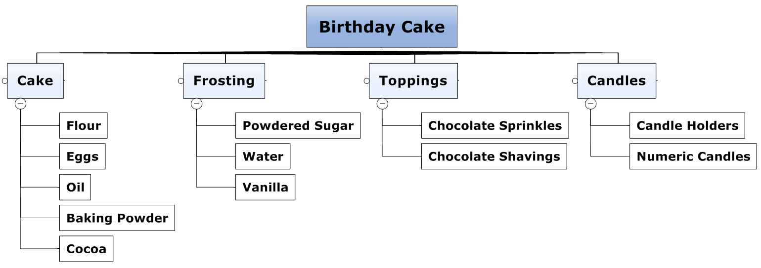
Figure 4-8. WBS for a Birthday Cake

Slide 30
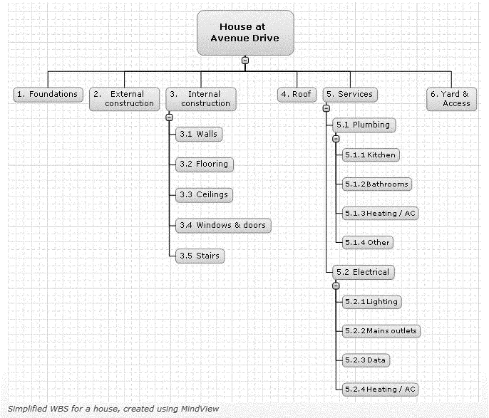
Figure 4-9. WBS for a House Showing 6 Main Deliverables (www.matchware.com)

Slide 31
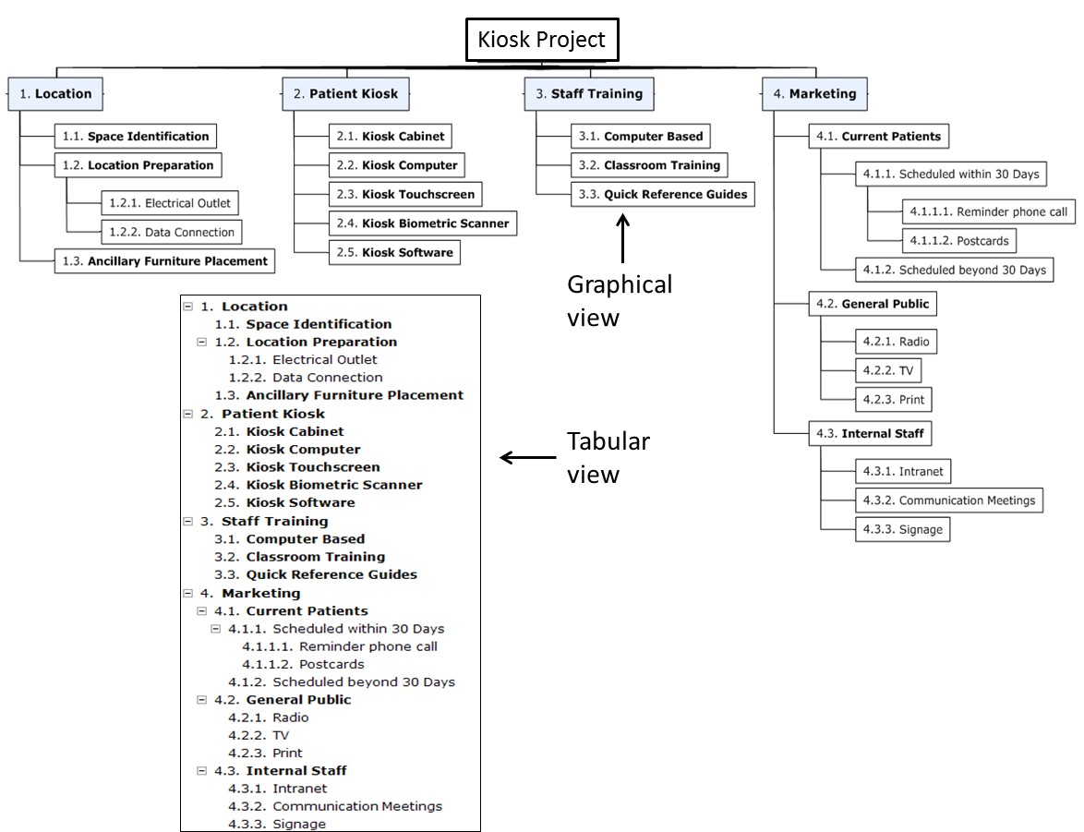
Figure 4-11. WBS for a Kiosk Project Showing Graphical and Tabular Formats

Slide 32
Creating a Good WBS
It is difficult to create a good WBS
The project manager and the project team must decide as a group how to organize the work and how many levels to include in the WBS
It is often better to focus on getting the top levels of the WBS done well to avoid being distracted by too much detail
Many people confuse tasks on a WBS with specifications or think it must reflect a sequential list of steps
You should focus on what work needs to be delivered, not when or exactly how it will be done

Slide 33
Creating the WBS Dictionary
A WBS dictionary is a document that describes the deliverables on the WBS in more detail
The format can vary based on project needs
It may also include who owns the work package, estimated cost and schedule information, contract information if outsourced, specific quality requirements, technical and performance requirements, etc.

Slide 34
Approaches to Developing WBSs
Using guidelines or templates: Some organizations, like the DOD, provide guidelines or templates for preparing WBSs
The analogy approach: Review WBSs of similar projects and tailor to your project
The top-down approach: Start with the largest items of the project and break them down
The bottom-up approach: Start with the specific tasks and roll them up
Mind-mapping approach: Mind mapping is a technique that uses branches radiating out from a core idea to structure thoughts and ideas

Slide 35
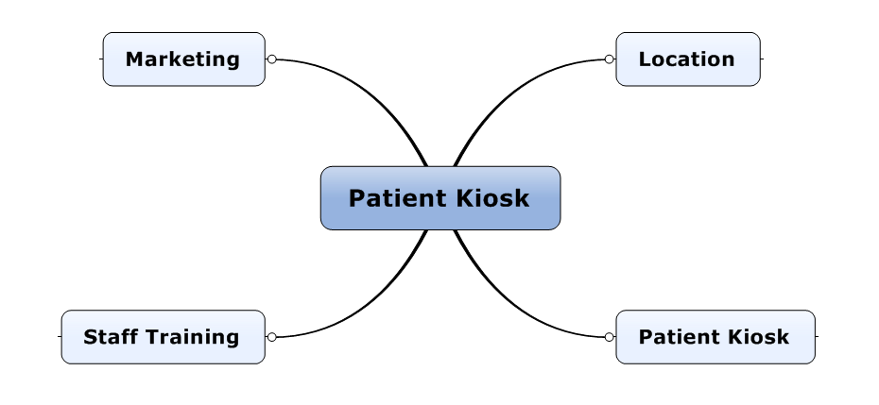
Figure 4-13. Patient Kiosk WBS Initial Mind Map

Slide 36
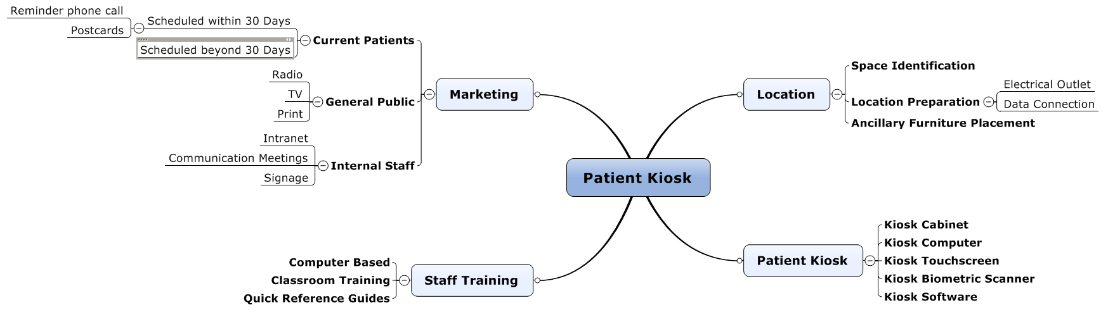
Figure 4-14. Patient Kiosk WBS Detailed Mind Map

Slide 37
Figure 4-15. Sample WBS

Slide 38
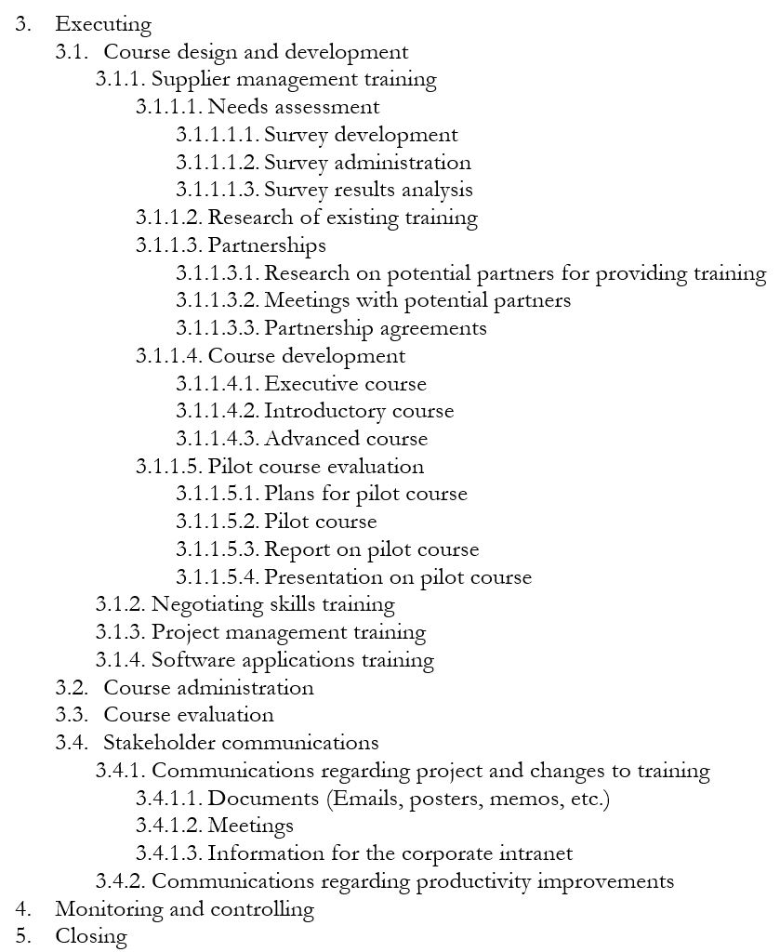
Figure 4-15. Sample WBS (continued)

Slide 39
Figure 4-16. Sample WBS Dictionary Entry

Slide 40
Quick Review Question

Slide 41
Summary of Main Teaching Points
Planning for integration management includes developing a project management plan. Plans in the other knowledge areas are considered to be subsidiary parts of the project management plan.
Planning processes for scope management include planning scope management, collecting requirements, defining scope, and creating a WBS
Approaches for developing a WBS include using guidelines or templates, an analogy approach, a top-down approach, a bottom-up approach, and mind mapping. A WBS dictionary provides more detail on WBS items

Slide 42
Question and Answer Session
Q & A

Slide 43
What we will cover next
05 Planning Projects Part 2 (Cost & Time)

